Slide 1
Greek Coins

Slide 3
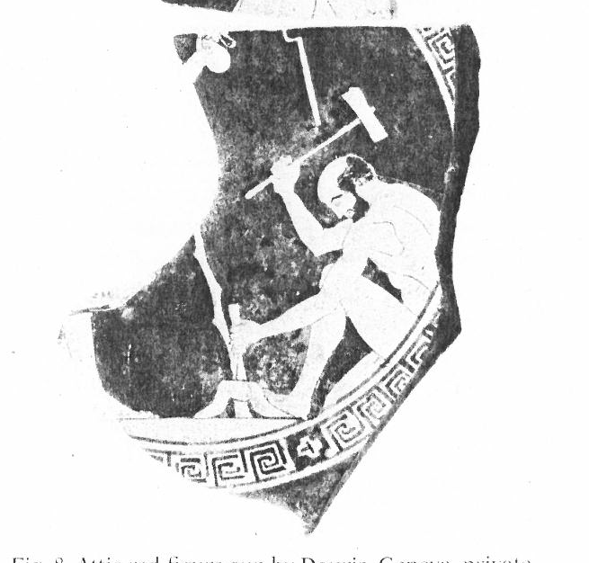

Slide 4
Gods and Goddesses
Zeus/Elis

Slide 5
Myths and Heroes
Pegasos/Corinth

Slide 6
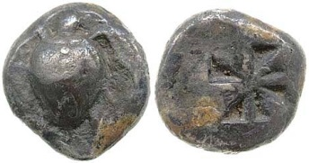
Plants and Animals
Turtles/Aegina

Slide 7
Athens
obverse
reverse

